Slide 1
DAY 3
EGYPT
Summer Camp 2024

Slide 2
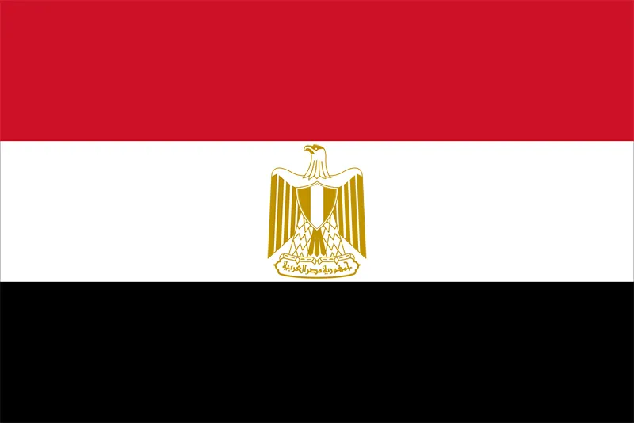
LET’S LEARN ABOUT EGYPT
Egypt
Cairo
Capital city _______
Language________
Draw the Egyptian flag here
Arabic

Slide 3

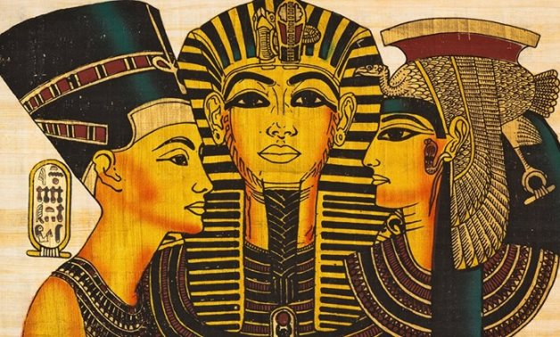
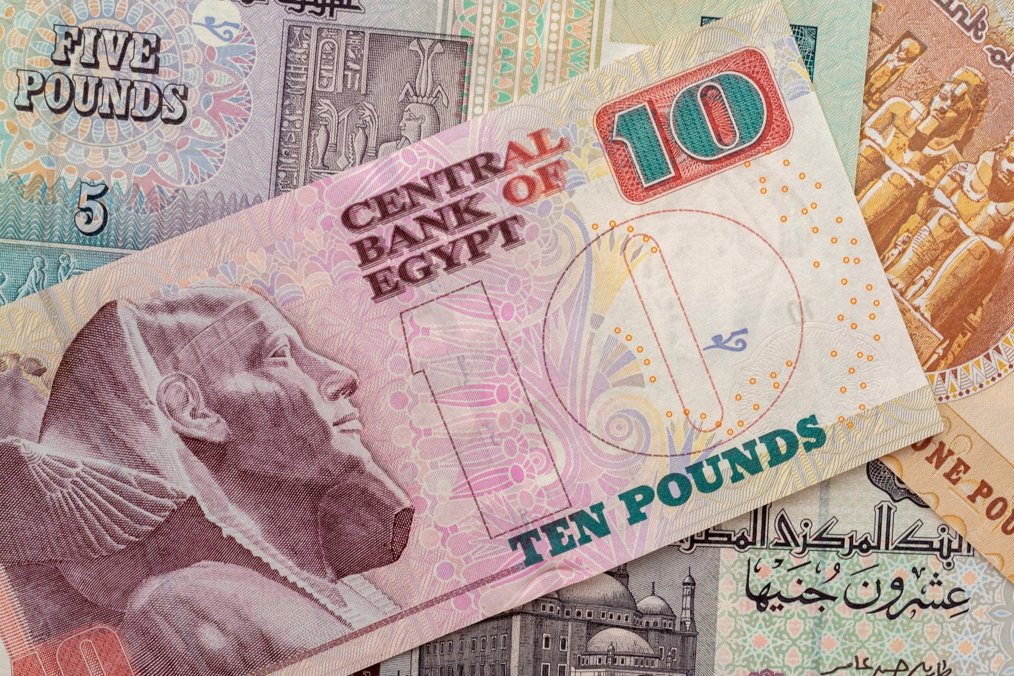
LET’S LEARN ABOUT EGYPT
Nile
The ________ is the l o n g e s t river in the world
Cut and paste Egyptian Pound here
Egyptian King was called a ____________
Pharaoh

Slide 4
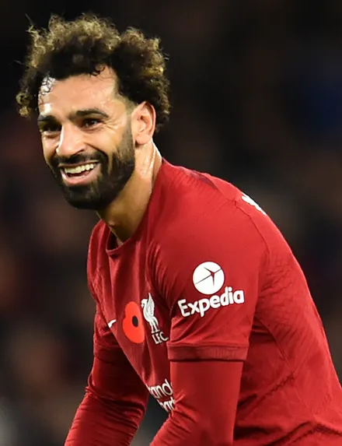
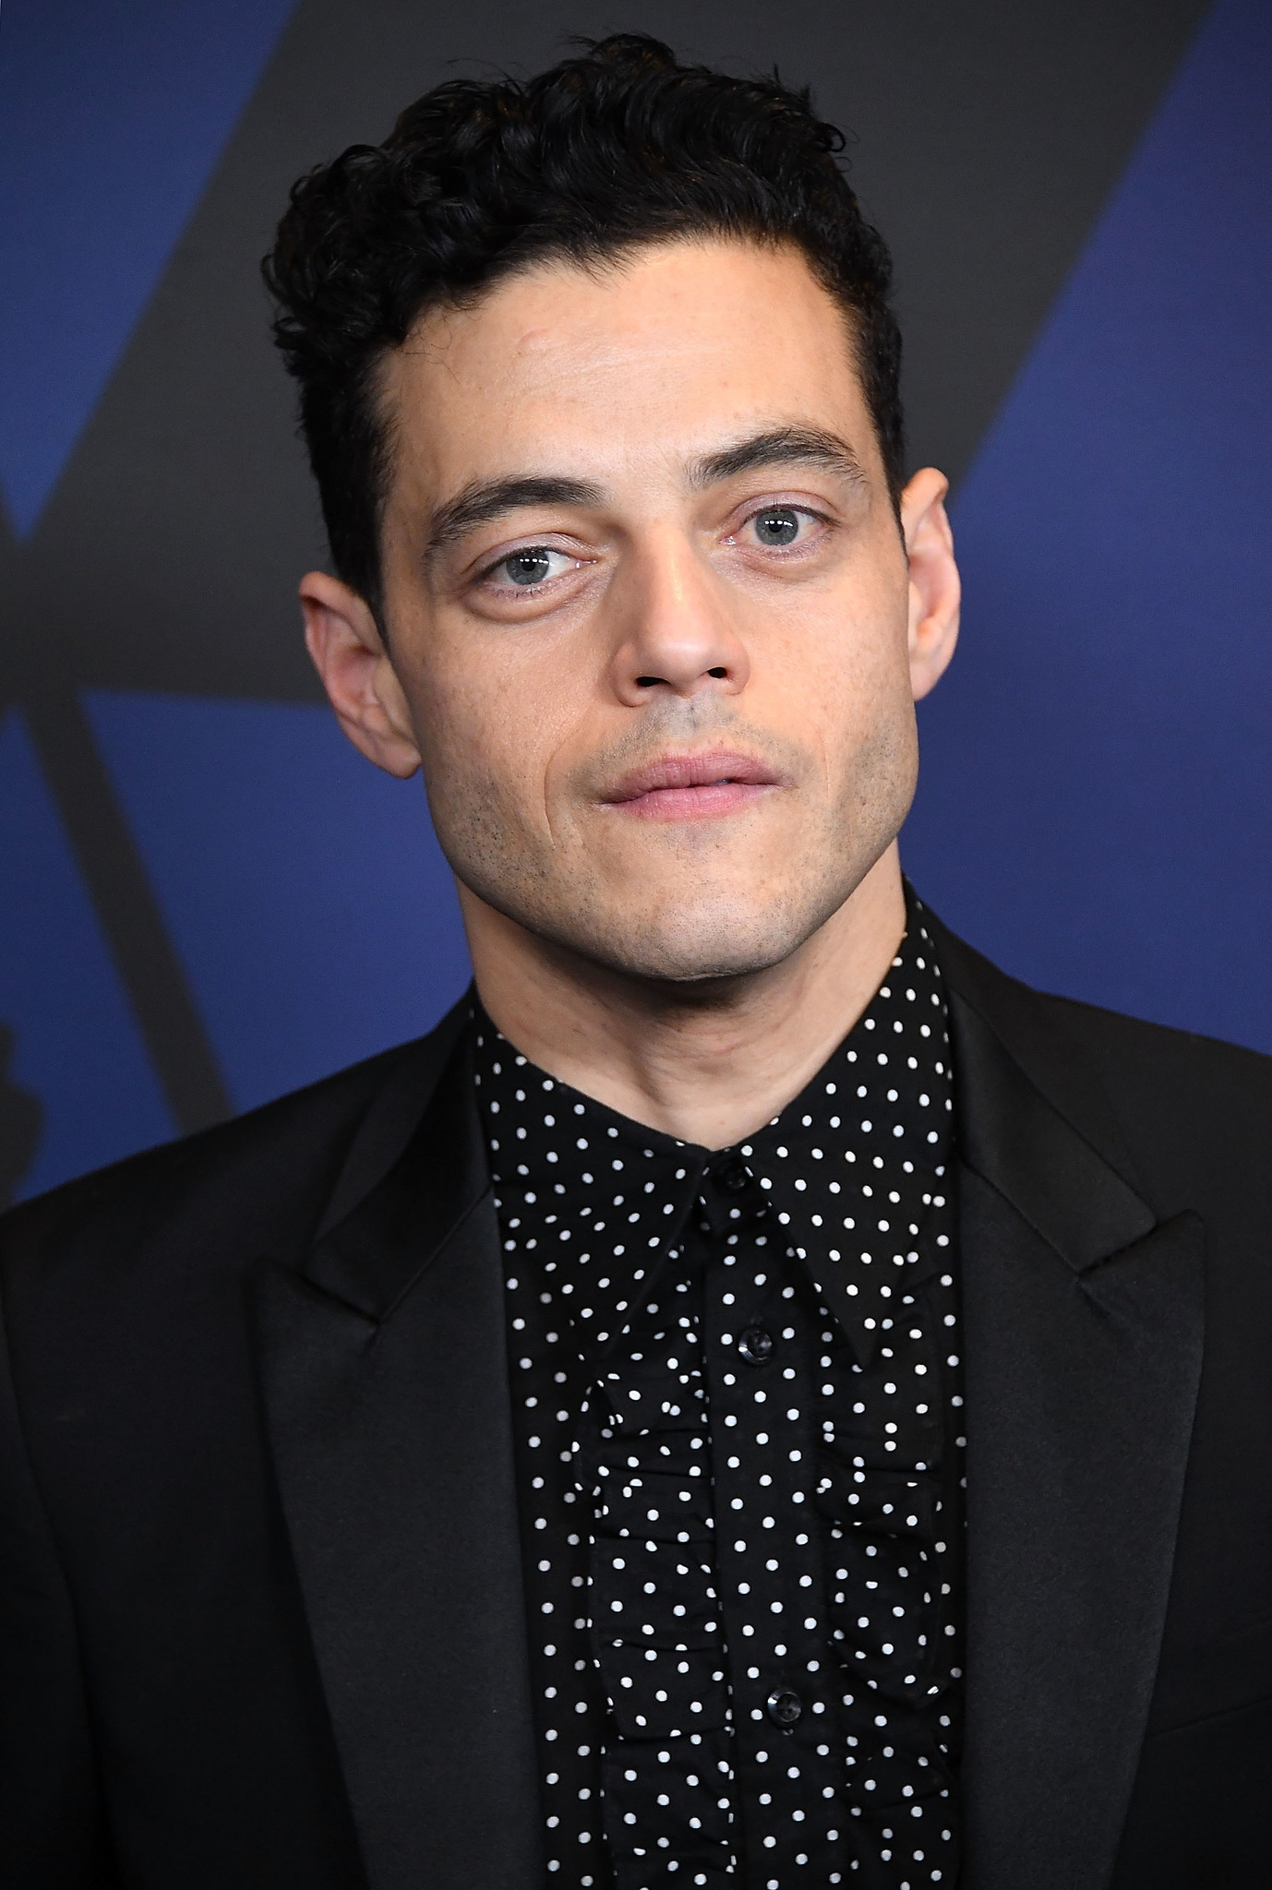
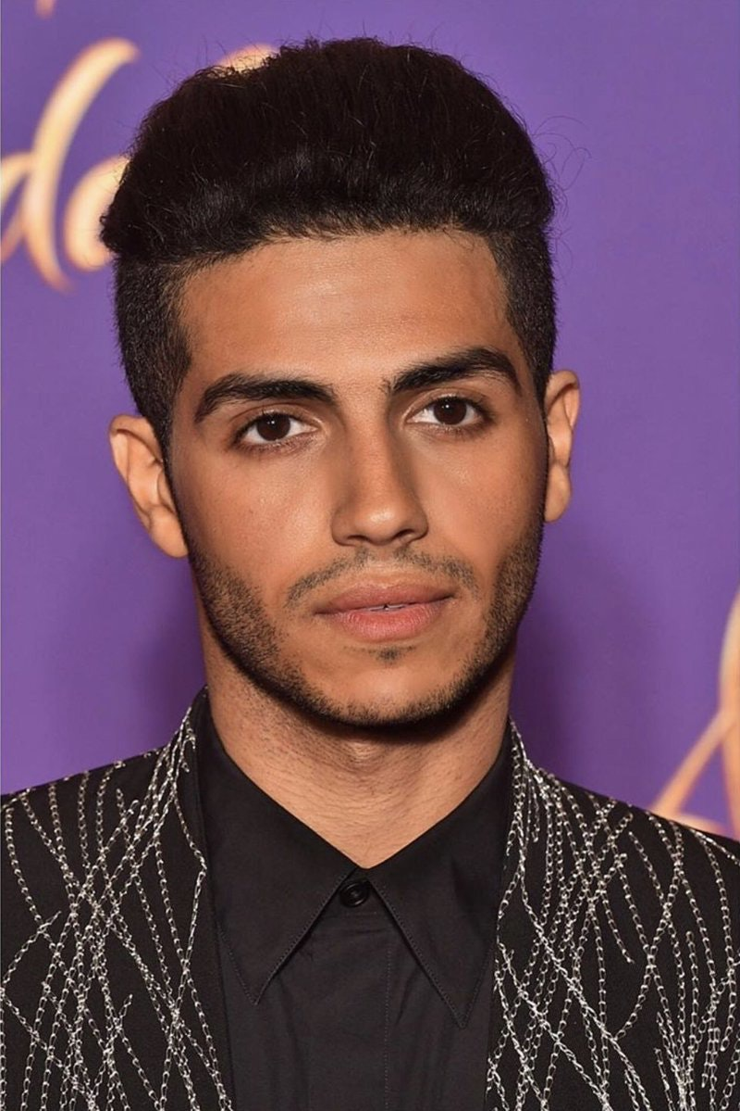
FAMOUS PEOPLE FROM EGYPT
I’m Mohamed Salah. I am a _________ for _________.
I’m Rami Malek. I am an _______.
I’m Mena Massoud. I am also an _______.
footballer
actor
actor
Liverpool

Slide 5
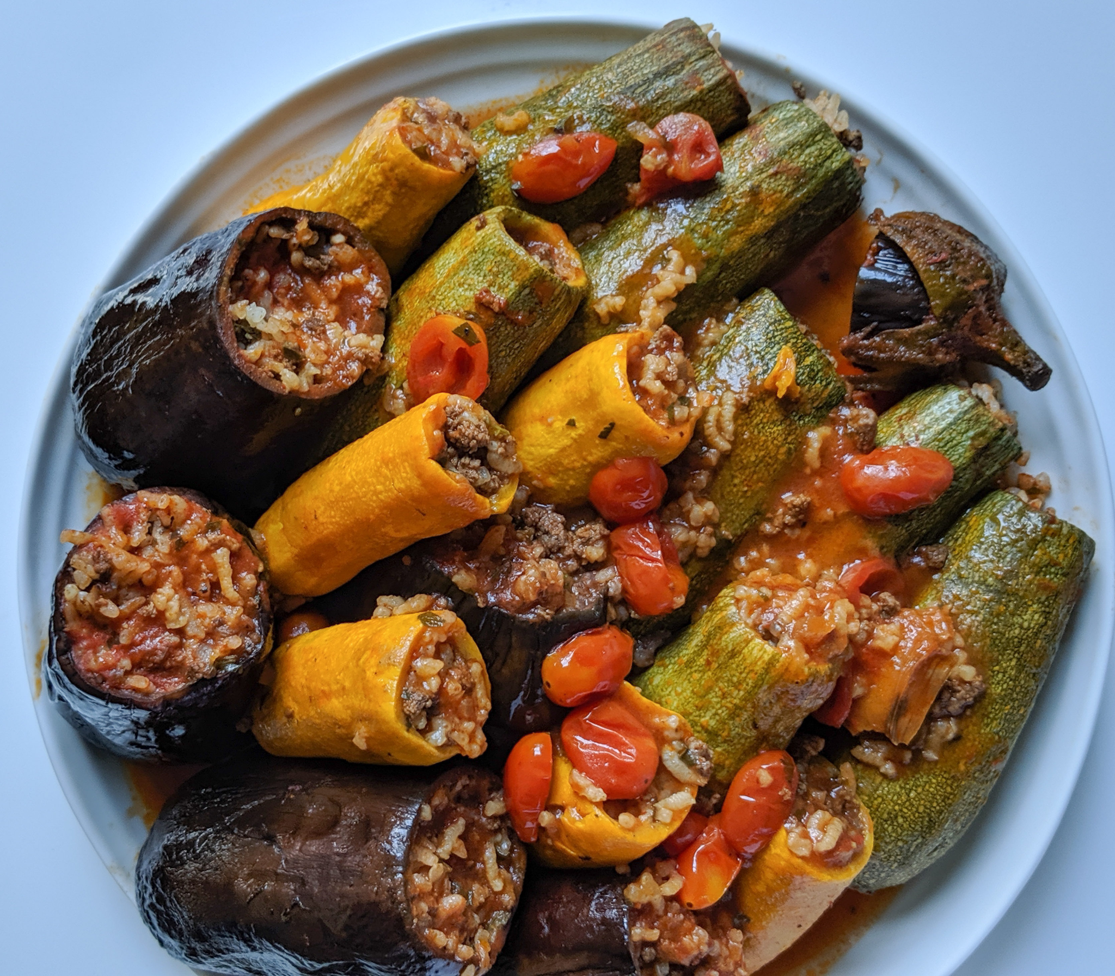
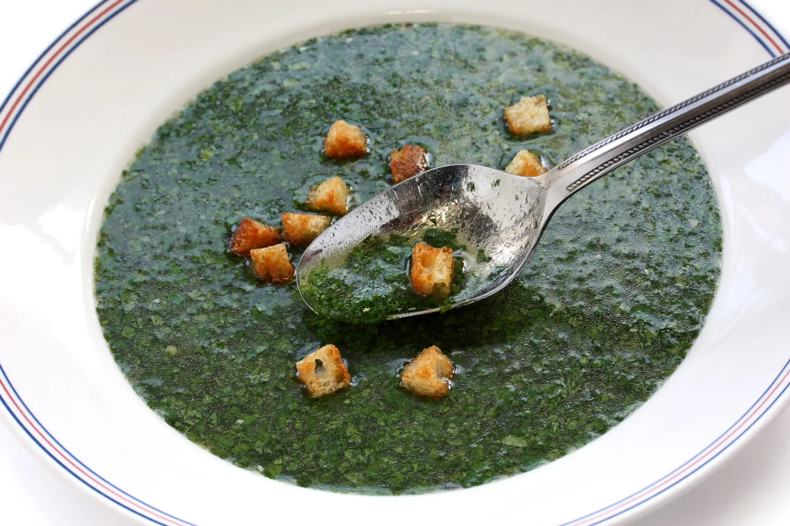
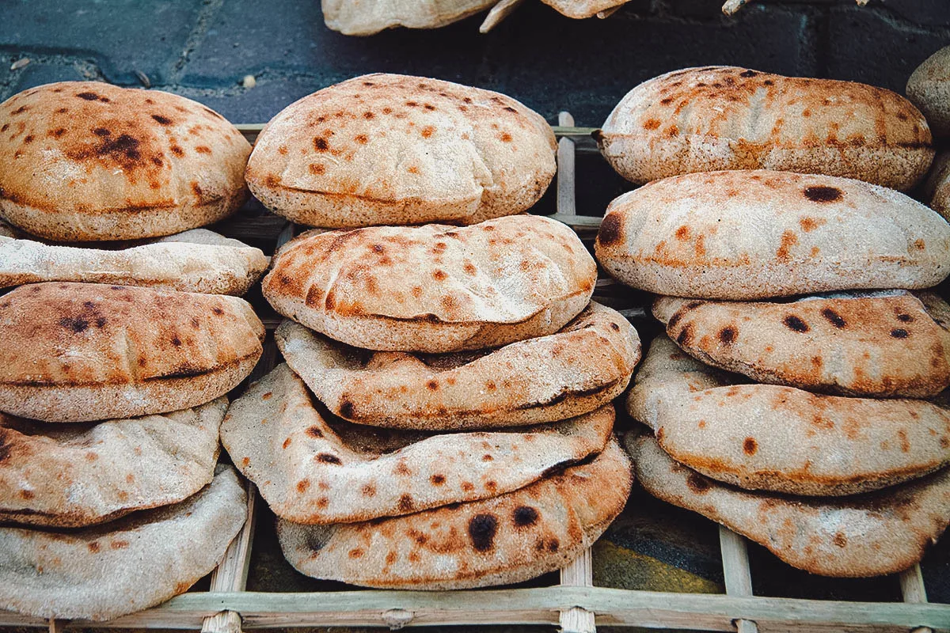
EGYPTIAN CULTURE AND FOOD
Molokhia
Mahashi
A soup made with leaves from the molokhia plant.
Stuffed vegetables
Aish baladi
Flatbread

Slide 6
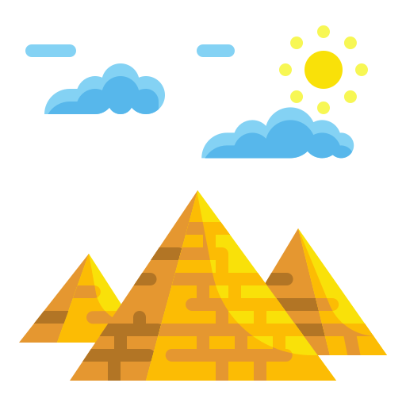
FUN FACT ABOUT ANCIENT EGYPT
Around 118
___________
pyramids have been found.

Slide 7
HIEROGLYPHICS

Slide 8
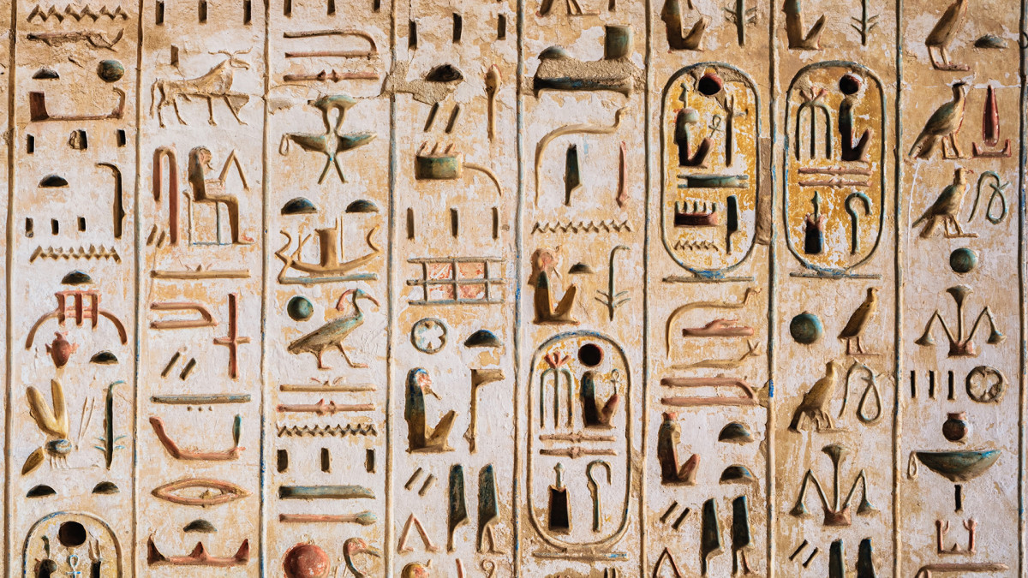
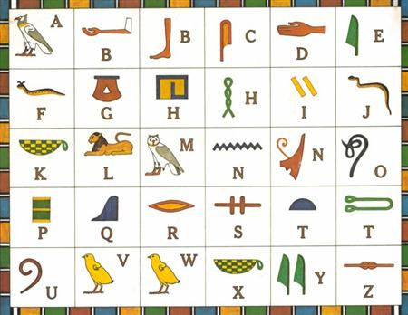
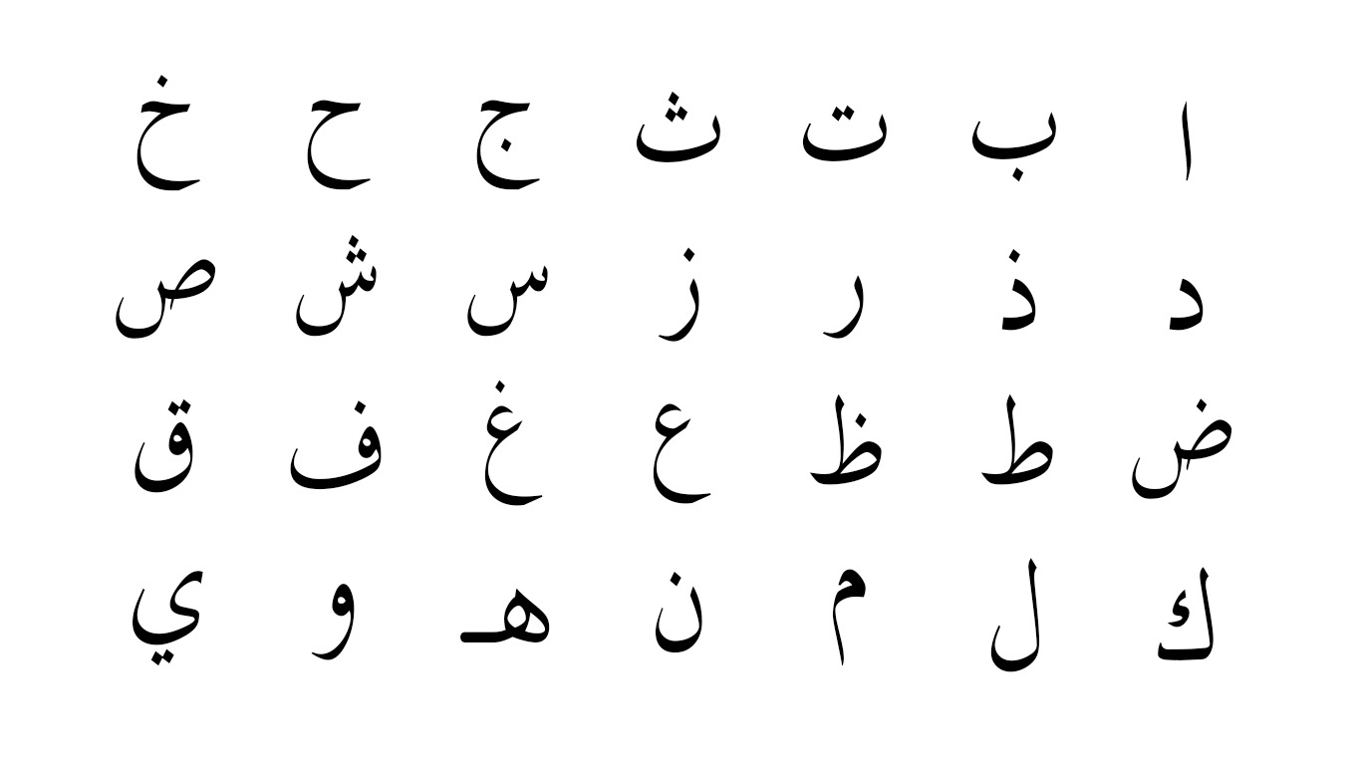
HIEROGLYPHICS
Before using the Arabic alphabet, Egyptians used hieroglyphics.

Slide 9
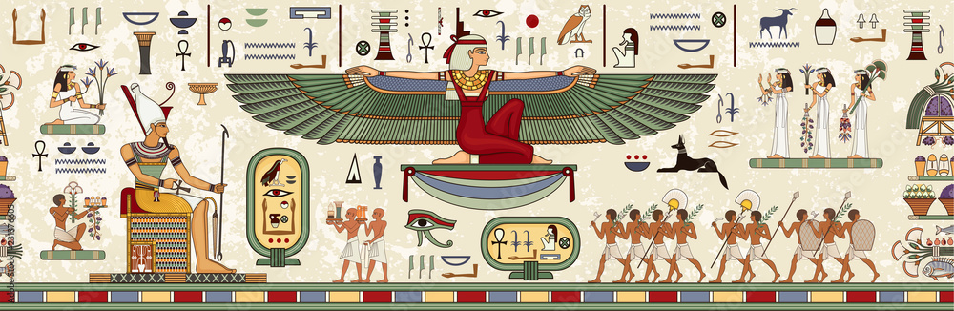
HIEROGLYPHICS
They used pictures instead of words. Some pictures were used for two English letters

Slide 10
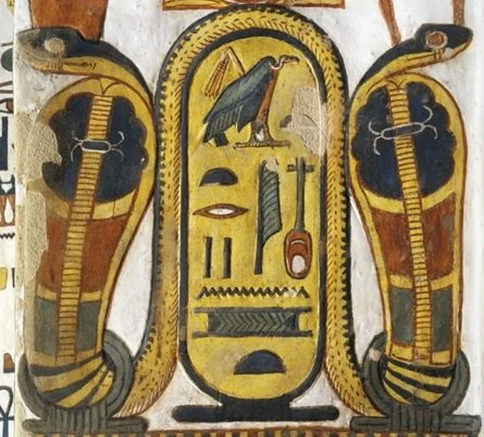
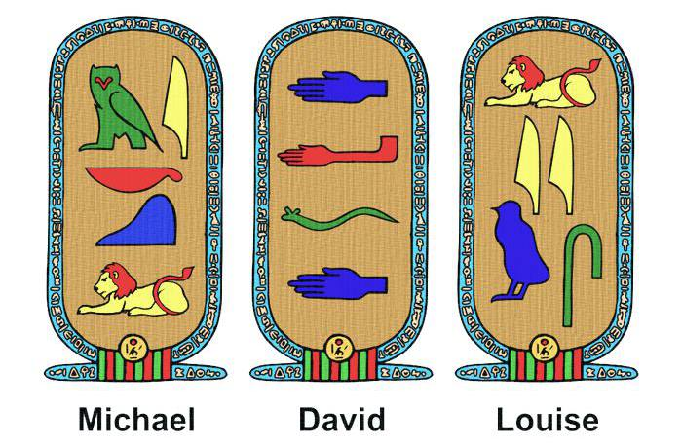
HIEROGLYPHICS
An Egyptian name tag is called a ‘cartouche’.

Slide 11

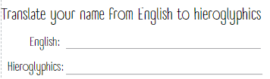
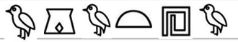
IN YOUR BOOK…
Write your name in English and in hieroglyphics
Practice your cartouche design
Agatha

Slide 12
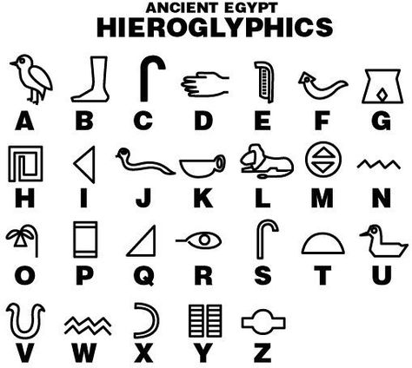

Slide 13
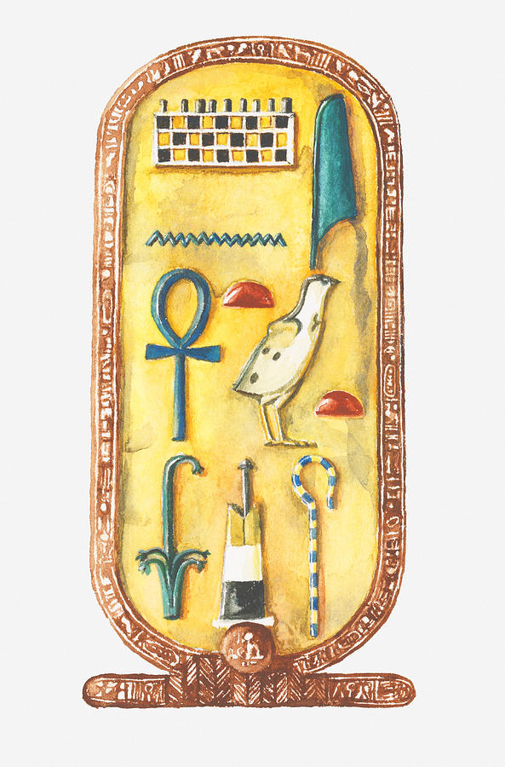
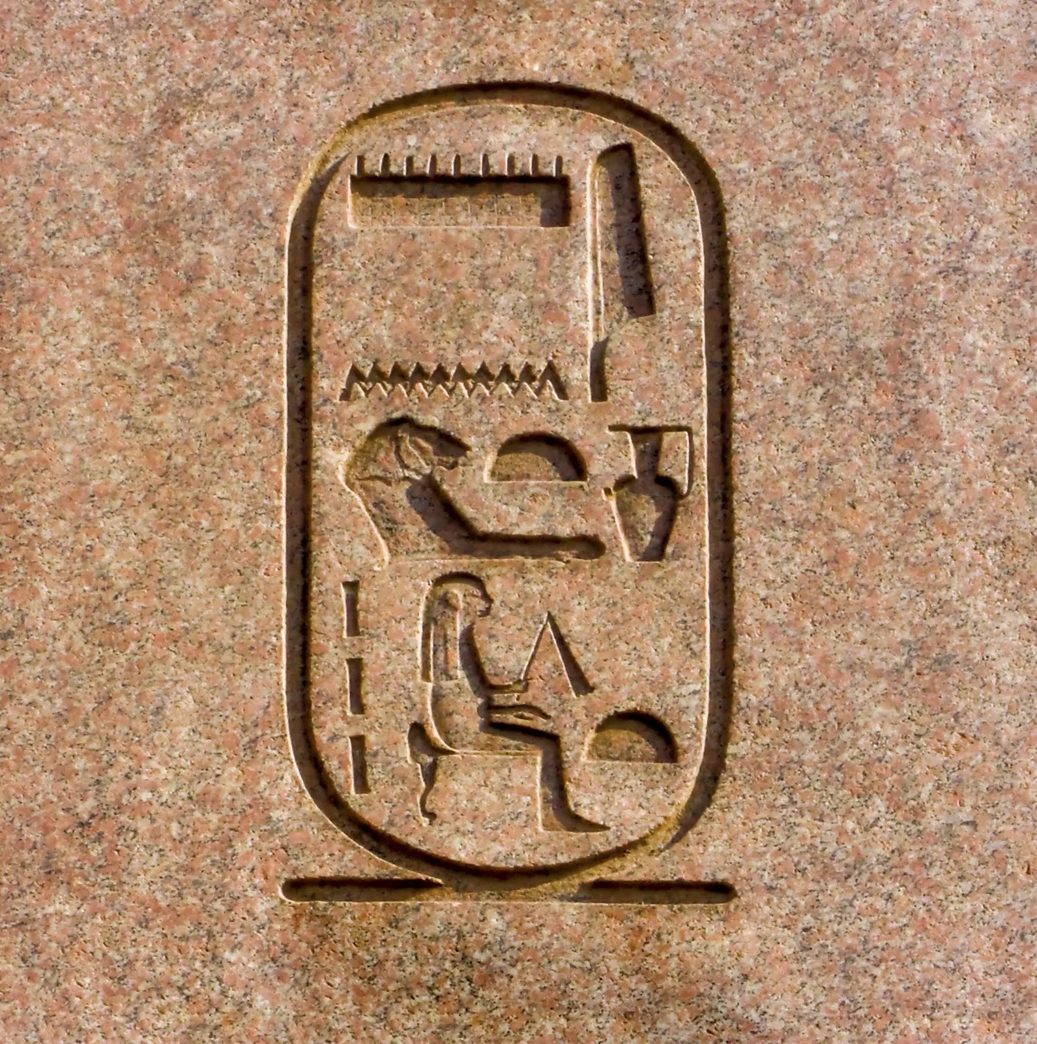
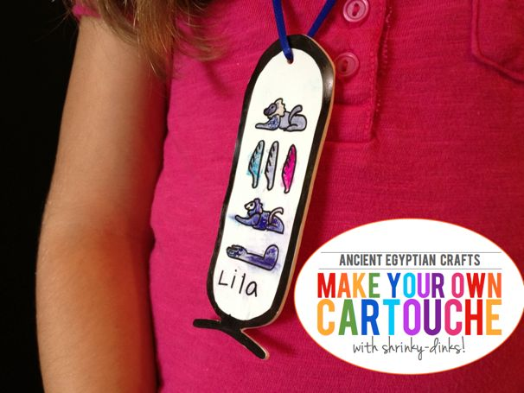
MAKE
YOUR OWN CARTOUCHE
Practice your design in you book
Agatha
REMEMBER!
Names were written from top to bottom

Slide 14
SECRET CODE (Cipher)
RACE

Slide 15
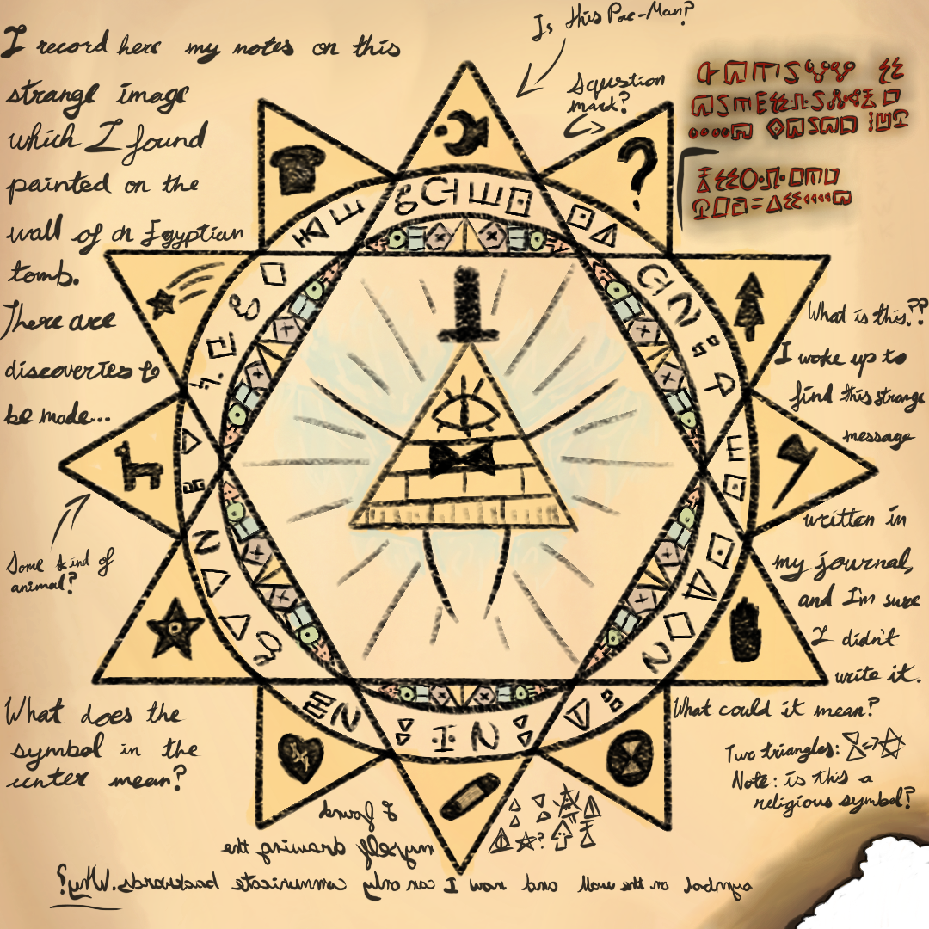
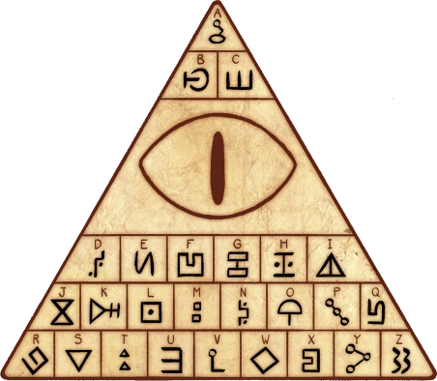
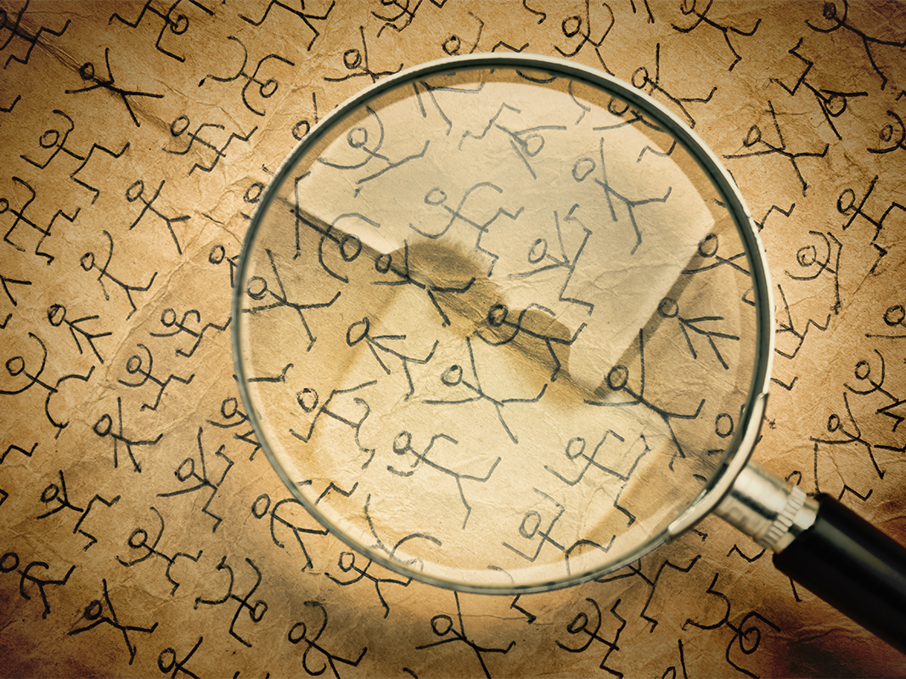
WHAT IS A CIPHER?
A cipher is a message written in a secret code.

Slide 16
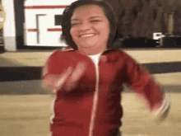
Secret Code (Cipher) RACE
Translate the hieroglyphics into English
Notes:
Read the clue
Find the next clue
The clues are inside the school building
Only take YOUR team’s color clues
DON’T MOVE OTHER CLUES

Slide 17
PASSPORT WRITING

Slide 18
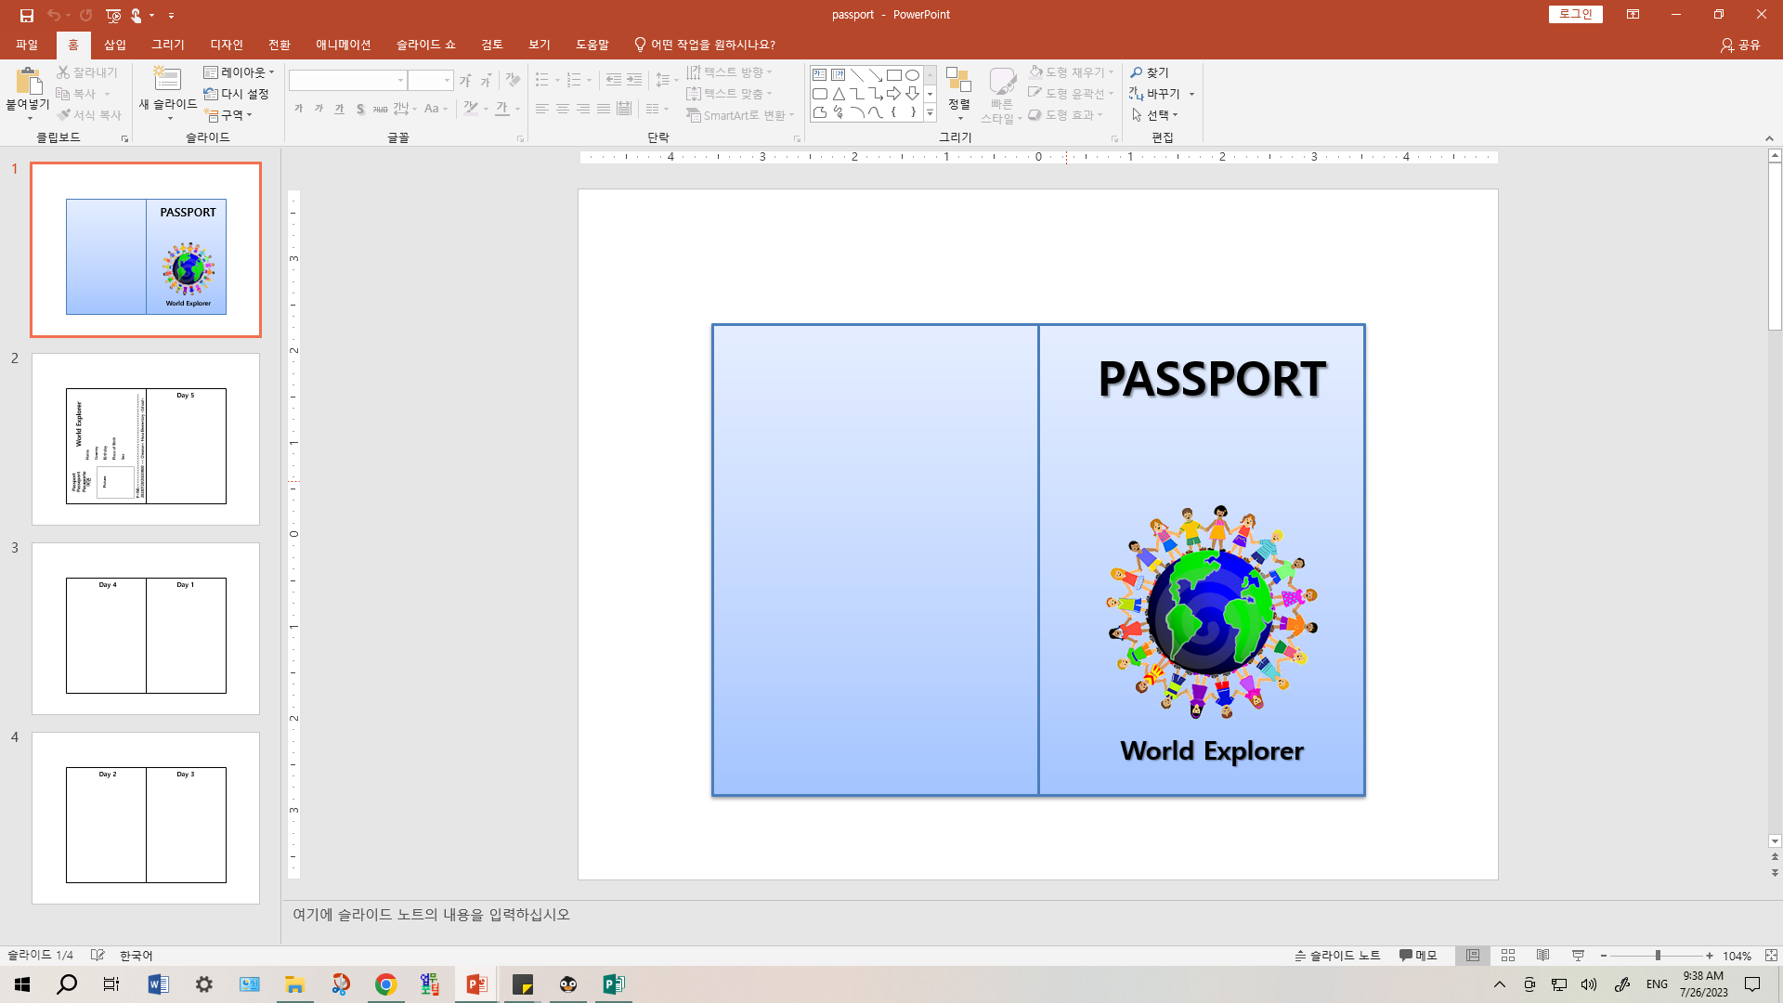
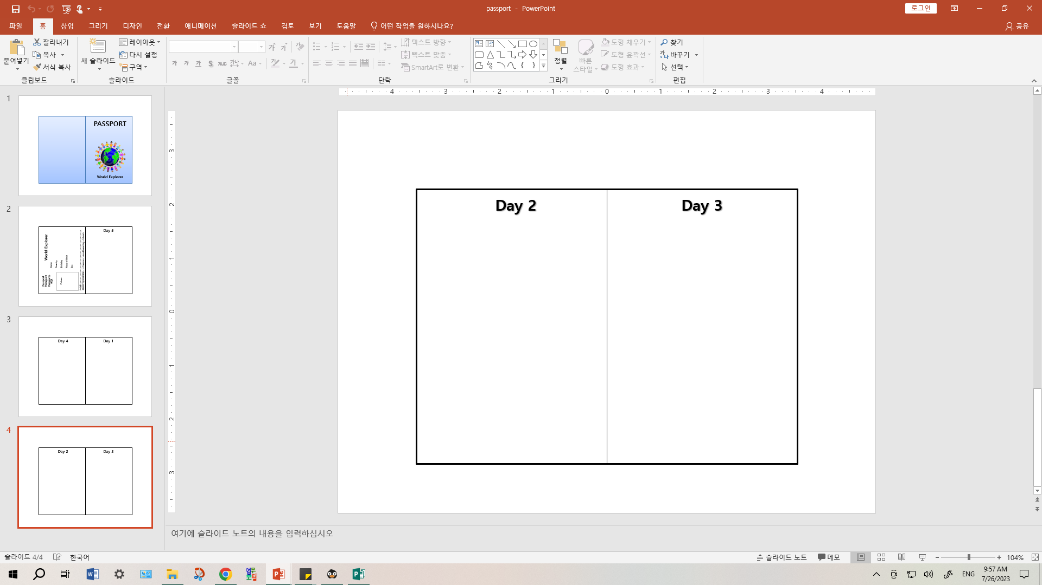
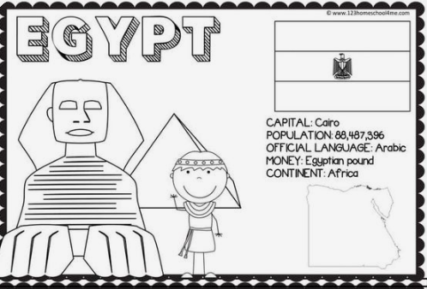
PASSPORT WRITING

Slide 19
